Slide 1
CORE MEDICAL CENTRE

Slide 2

Meet Our Team

Slide 3
INTRODUCTION
The goal of this project is to develop a web-based application that provides a user-friendly interface for doctors and their staff to manage patient information and medication records. The system aims to streamline the process of registering staff members, recording patient details, and managing prescribed medicines. By leveraging the power of a well-designed database and intuitive user interfaces, this project aims to enhance the efficiency and accuracy of healthcare data management.
The web-based application will provide a comprehensive interface for doctors, enabling them to register their staff, add patient information, and update medication records securely. Additionally, staff members will have their own authenticated access to the application, allowing them to view patient details and prescribed medications. The system will enforce role-based access control, ensuring that only authorized personnel can perform specific actions such as registering staff or editing patient information.
By developing a web-based application, this project introduces the advantage of accessibility. Users can access the system from any device with an internet connection, eliminating the need for specific software installations. Furthermore, the application can be deployed on a secure server, ensuring data privacy and compliance with healthcare regulations.

Slide 4
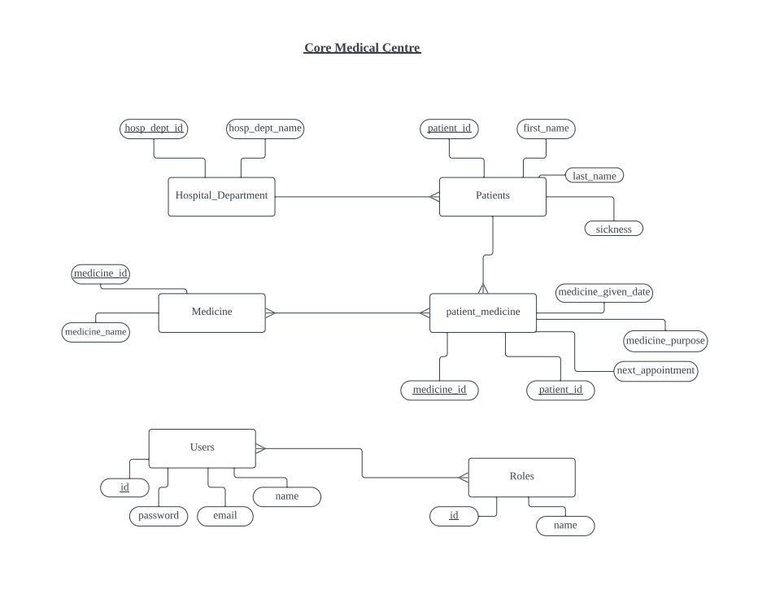
DATABASE DESIGN (WIREFRAME)

Slide 5
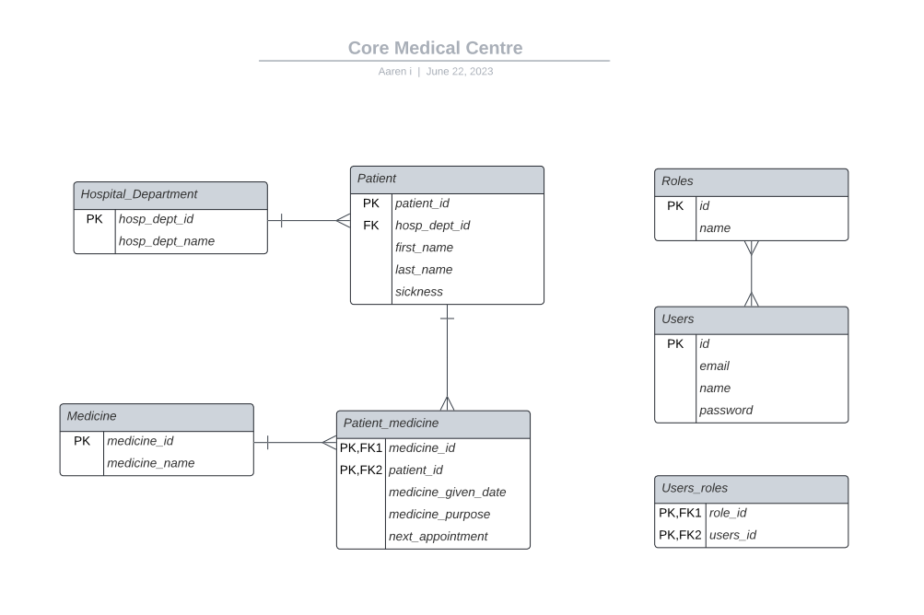

Slide 6
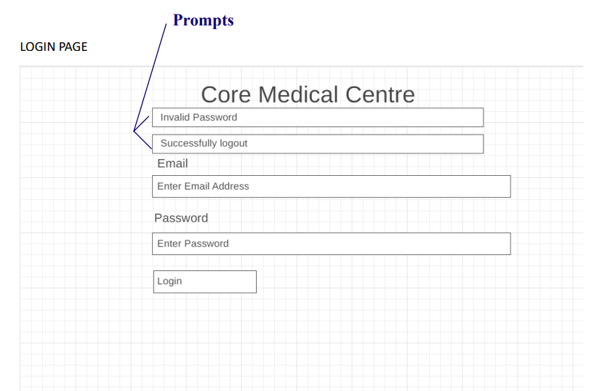
APPLICATION DESIGN

Slide 7
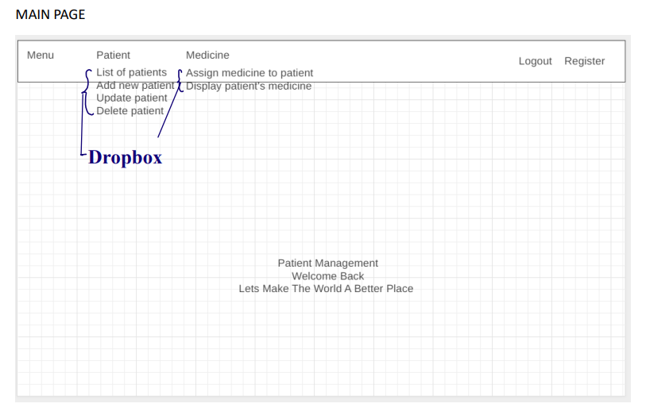

Slide 8
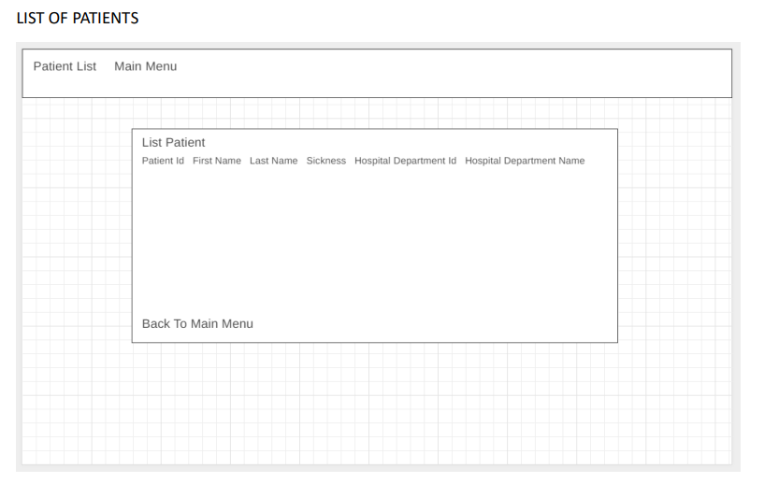

Slide 9
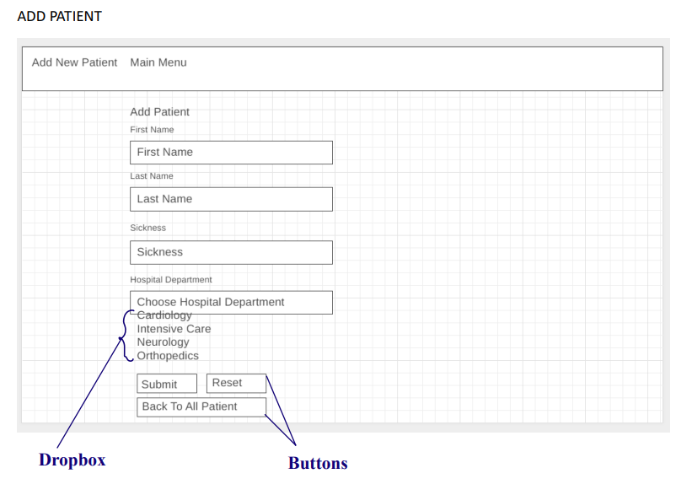

Slide 10
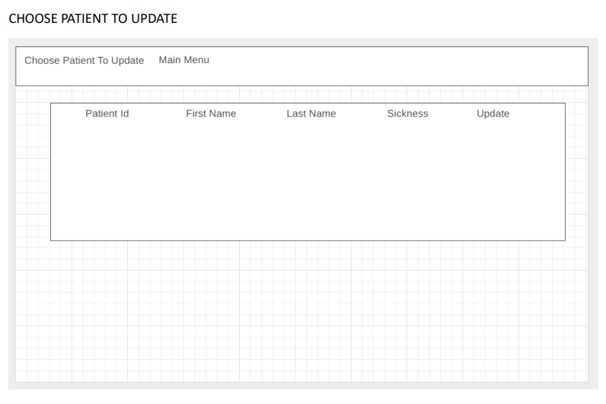

Slide 11
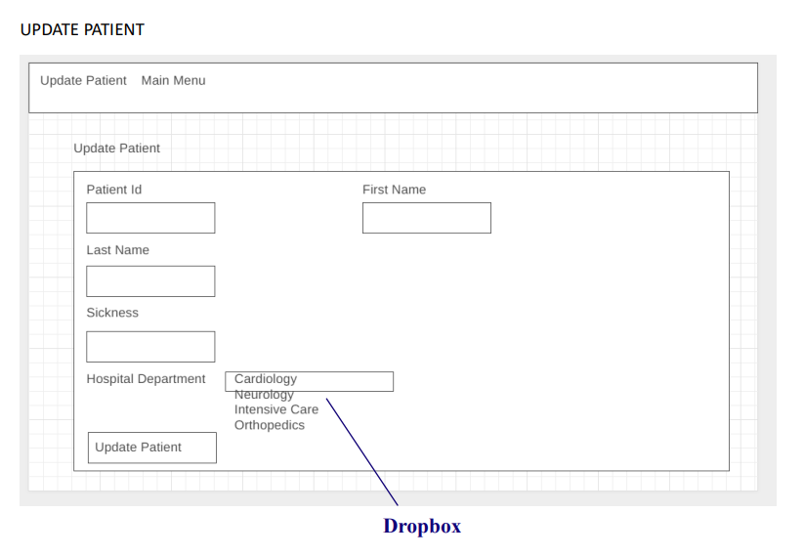

Slide 12
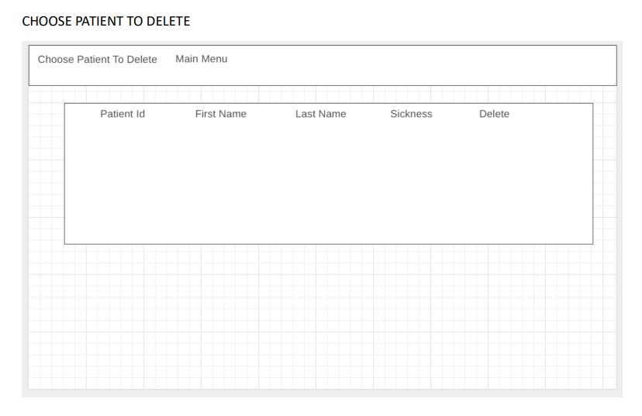

Slide 13
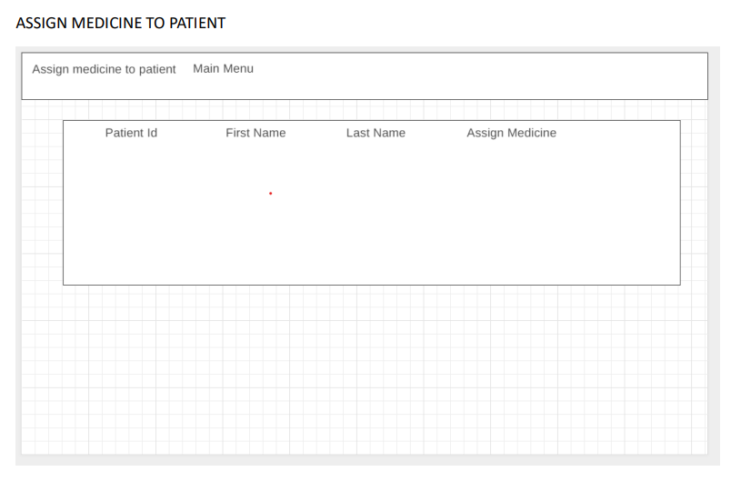

Slide 14
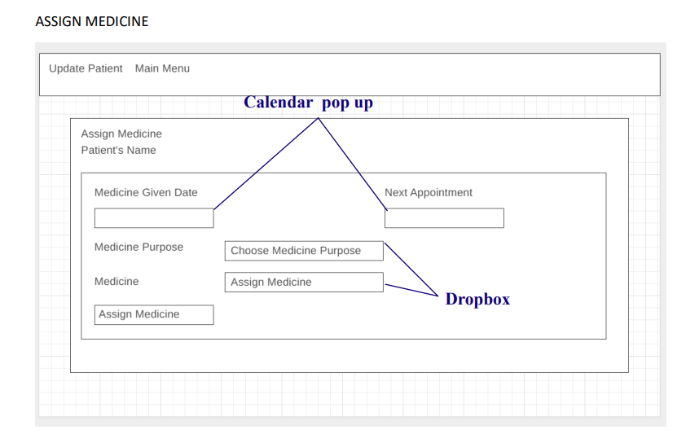

Slide 15
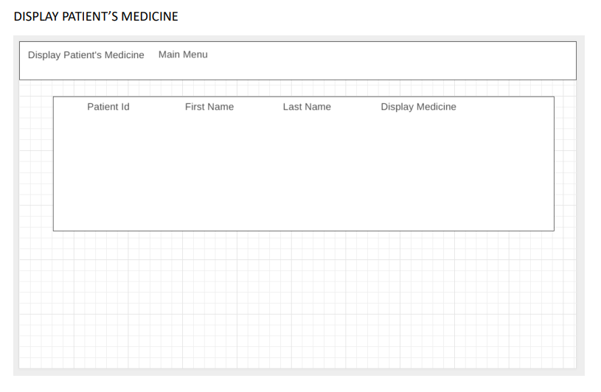

Slide 16
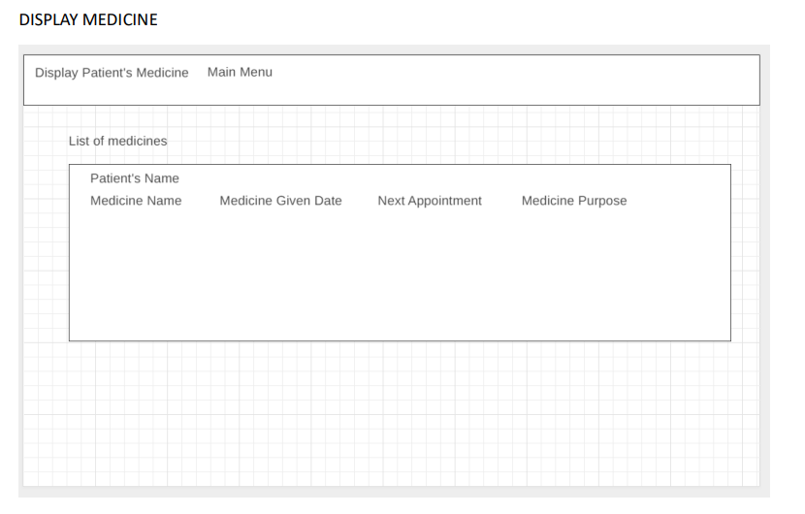

Slide 17
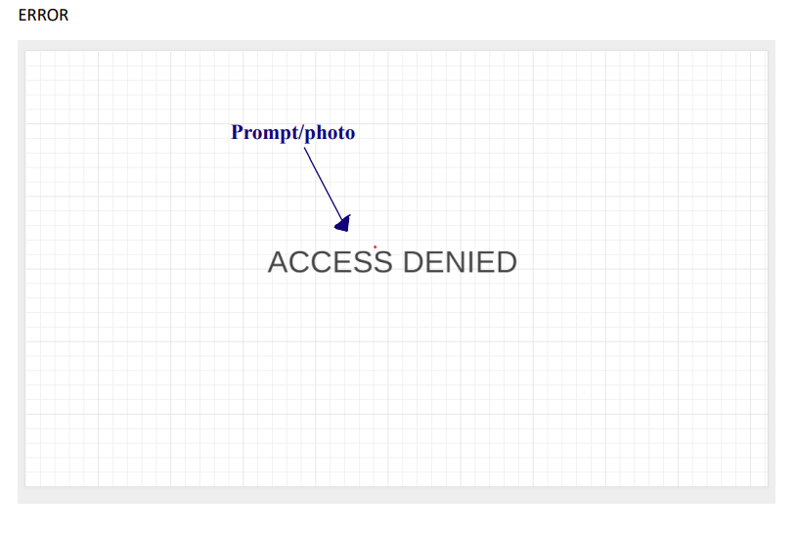

Slide 18
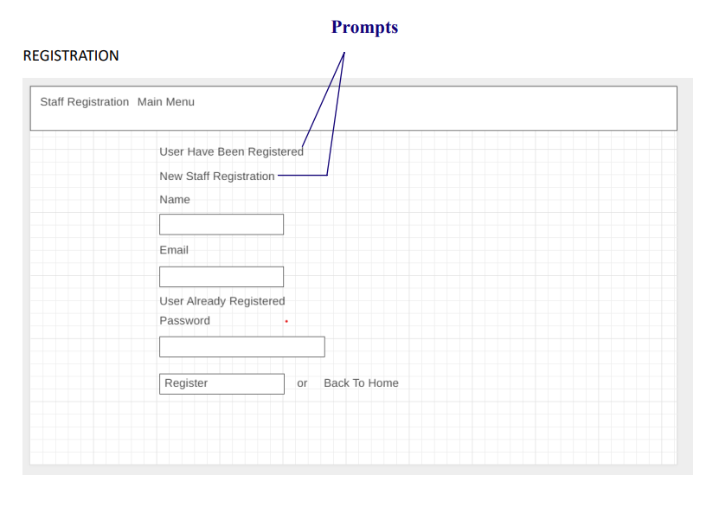

Slide 19
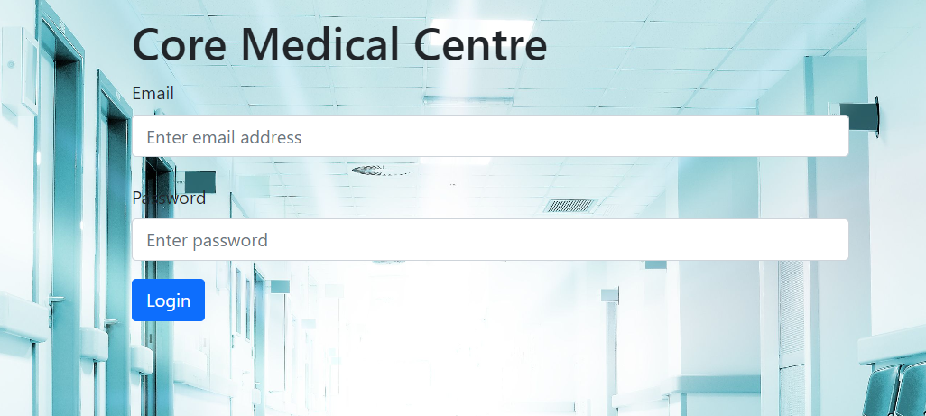
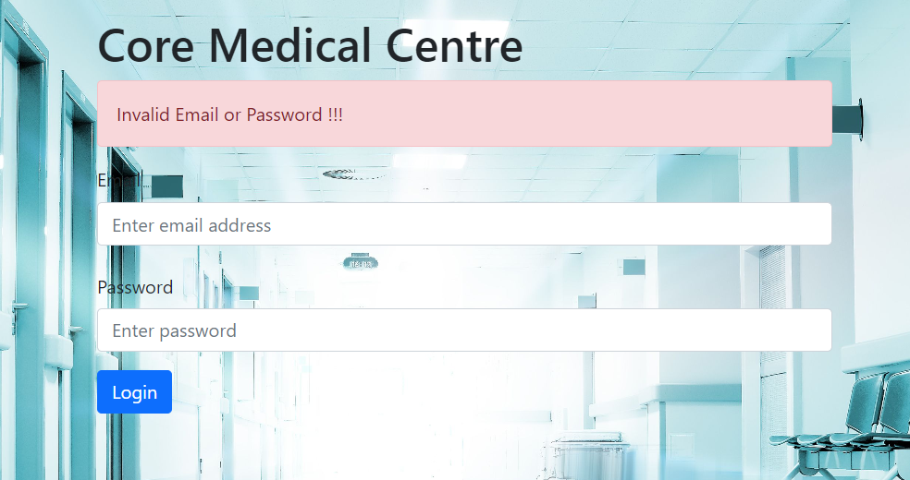
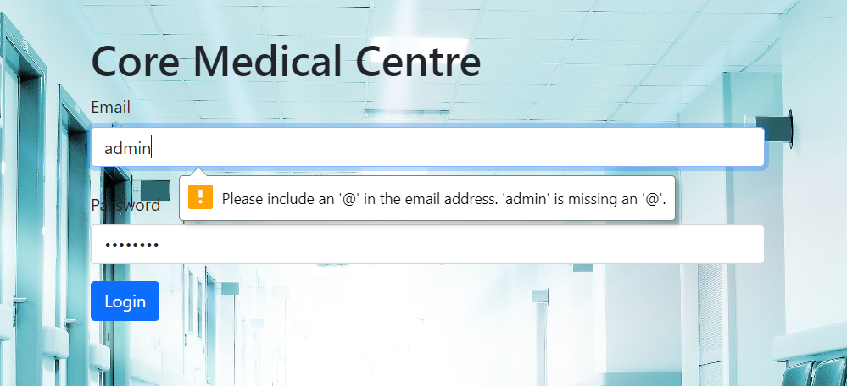
TESTING
Admin page
Incorrect Password / Email
Missing of @ in email
Missing of @

Slide 20

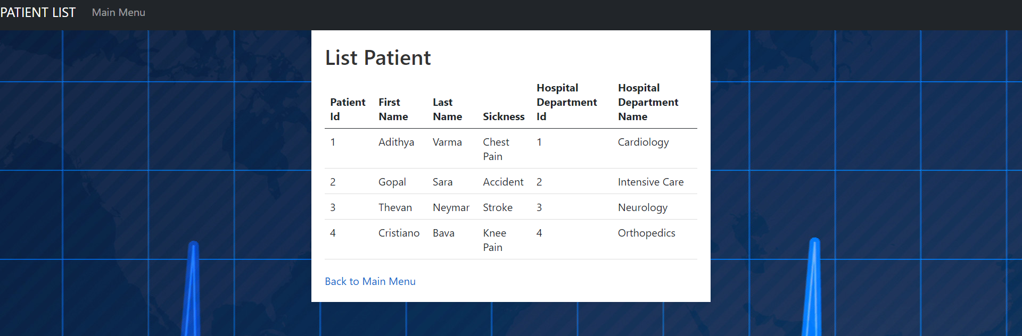
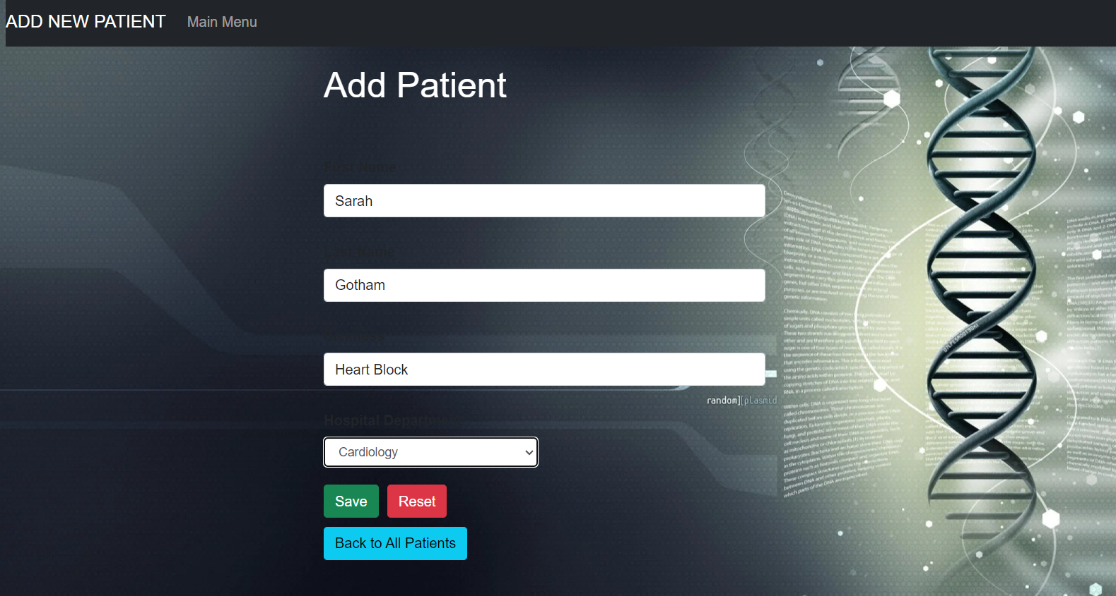
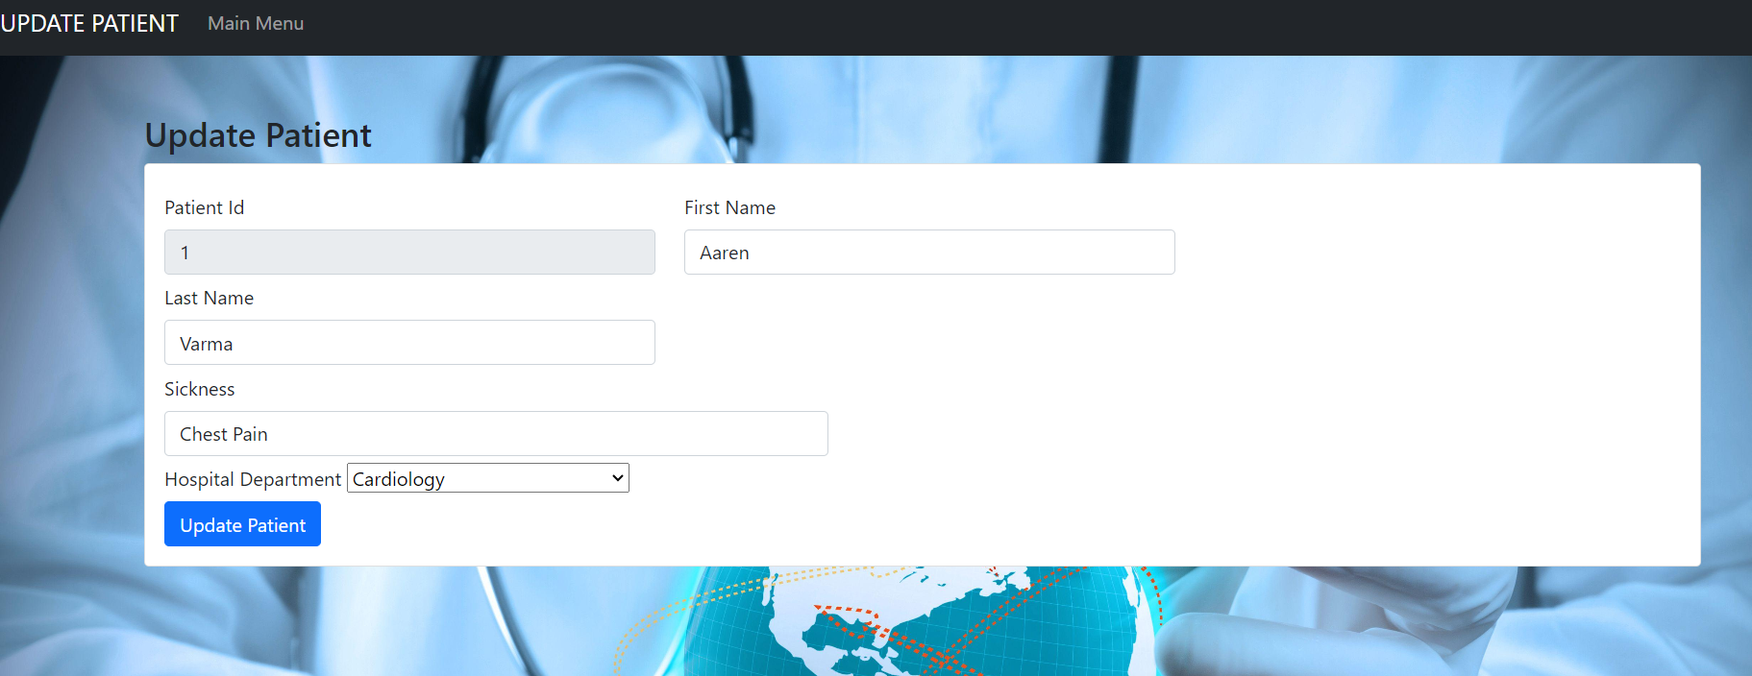
ADMIN
Page after logged in
List of patients
Add patient
Update Patient

Slide 21
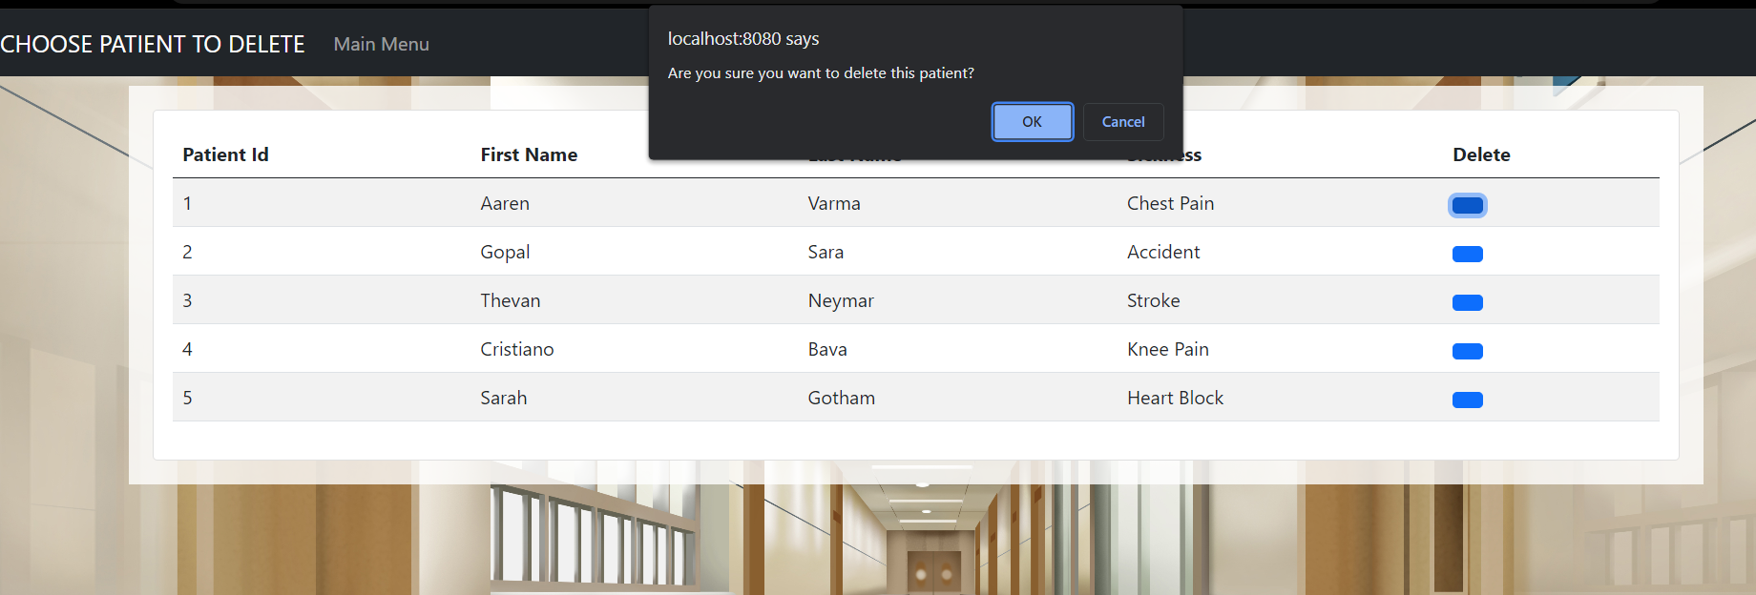
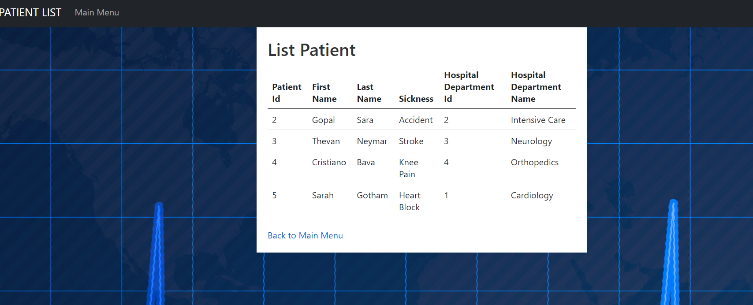
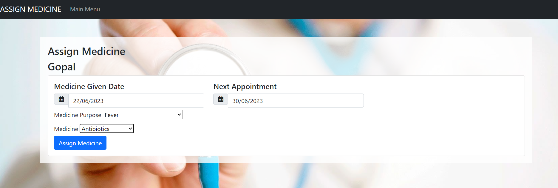
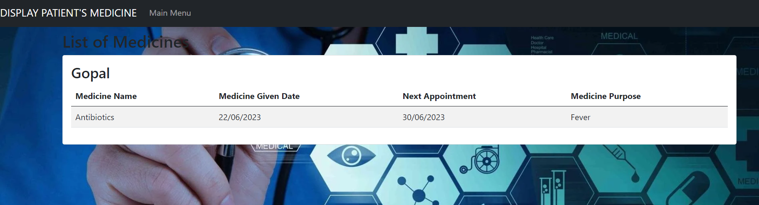
ADMIN
Delete patient page
Patient List Page list after ADD , UPDATE and DELETE
Medicine assign page
Display medicine page

Slide 22
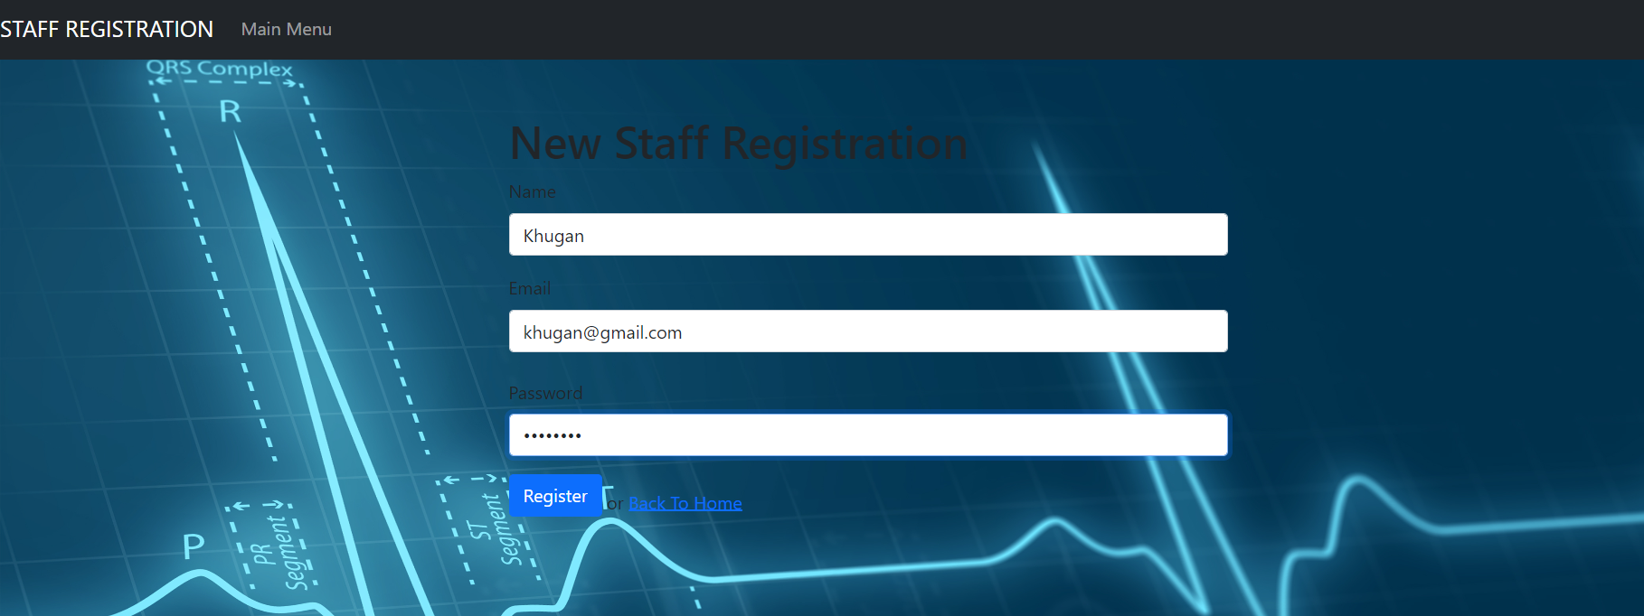
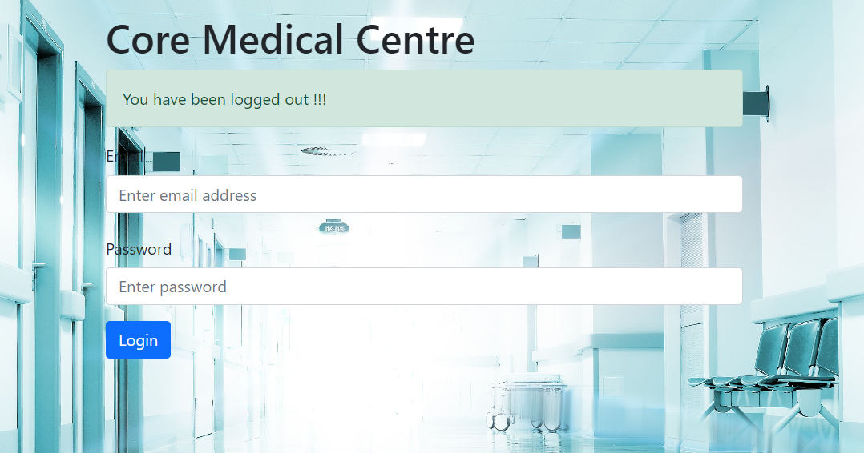
ADMIN
Staff registration page
Logout page

Slide 23

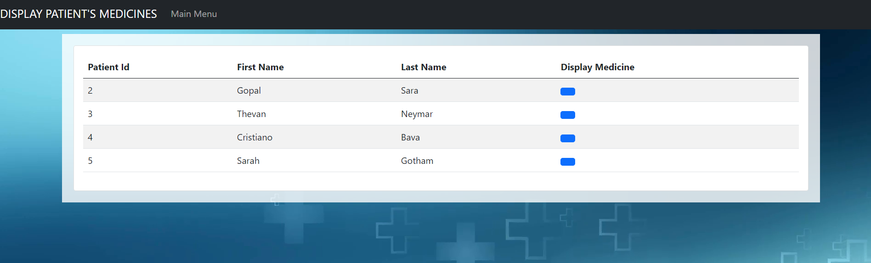
STAFF
Page after logged in
Access denied page (List , Add, Update, Delete and Assign Medicine to Patient)
Display Patient Medicine
Display Patient Medicine (after click on name)

Slide 24
CONCLUSION
In conclusion, this project has successfully developed a web-based application for healthcare data management. The application provides a user-friendly interface for doctors and staff to register staff members, record patient information, and manage medication records. With role-based access control and secure authentication, the application ensures data privacy and restricts access to authorized personnel. The web-based nature of the application enables easy access from any device with an internet connection, promoting flexibility and efficiency in healthcare data management. Overall, this project lays the foundation for future enhancements and advancements in healthcare data management systems, improving patient care and supporting medical professionals in their daily operations.

